Slide 1
CMU 10-742 Machine Learning in Healthcare
Lecture 6: Lies, Damned Lies, and Healthcare Data
Adam Berger

Slide 2
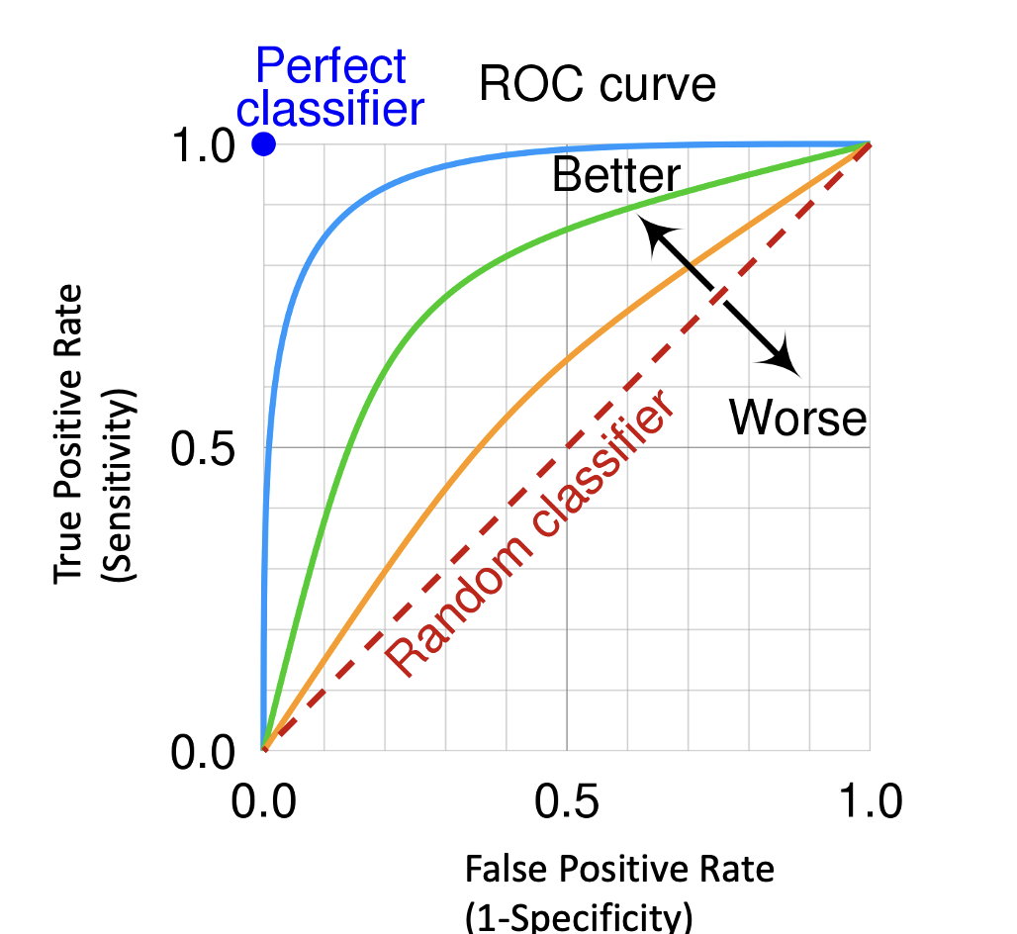
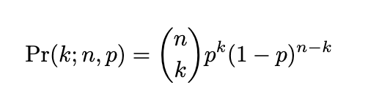
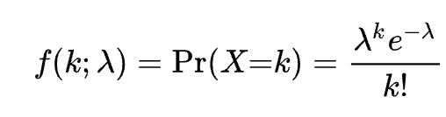
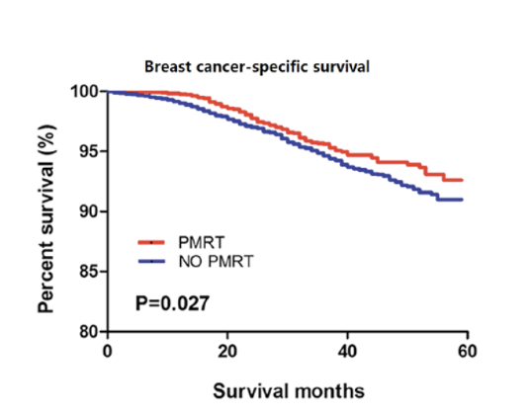
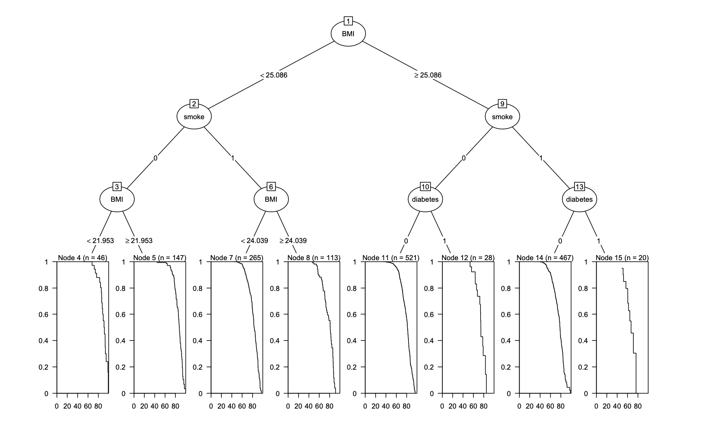
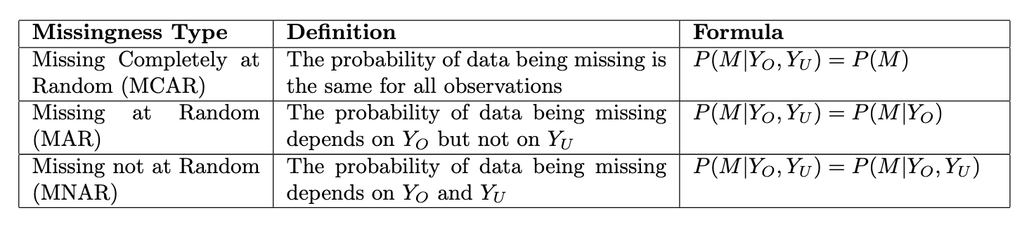
Lecture 5 Recap: Statistics & Survival Modeling

Slide 3
Course Logistics
Assignment 1 due today
Assignment 2 out today (due Sep 24)
Getting oriented in MIMIC data
Building a sepsis predictor
Handling missing data
Simpson’s paradox
Next week: health insurance
Note pre-class “reading questions”

Slide 4
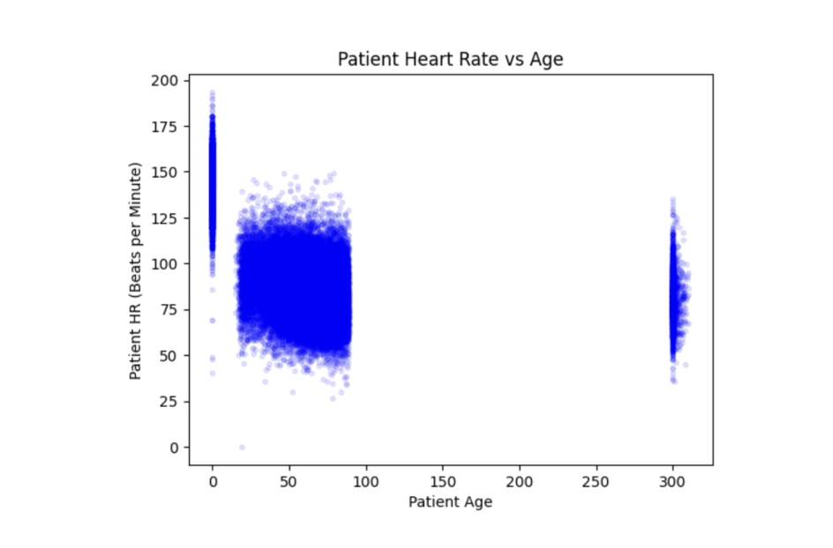
Motivating Example (1)
https://proceedings.mlr.press/v182/boag22a/boag22a.pdf
Notes:
(Paper was an assigned reading for this lecture)
A few weird things going on here. What are they?
Data points after 300 yrs old
Clump at 0
Why nothing between 0 and ~10? (this one I don’t know)
Mean age, mean heart rate – totally misleading
Understand your data. EDA

Slide 5
Motivating Example (2)
“…patients who came to the emergency department and died quickly did not have many symptoms entered into the EHR.”
As a result, [a] study using EHR data showed that the apparently healthiest patients died at a higher rate than sicker patients.”
https://academic.oup.com/jamia/article/20/1/117/2909152
Notes:
Makes perfect sense. But what might a predictive model learn from this?
Clearly, lack of symptoms in EHR is not a *cause* of death, it’s just correlated.
(What example from an earlier lecture does this remind you of? (prescribe troponin test -> MI)

Slide 6
Confounding Variable
No symptoms in EHR
Die quickly
Notes:
Teasing the later lecture on causality
Confounder:
near death -> no symptoms and
near death -> die quickly in ED

Slide 7
Confounding Variable
No symptoms in EHR
Die quickly
Deathly ill upon arrival

Slide 8
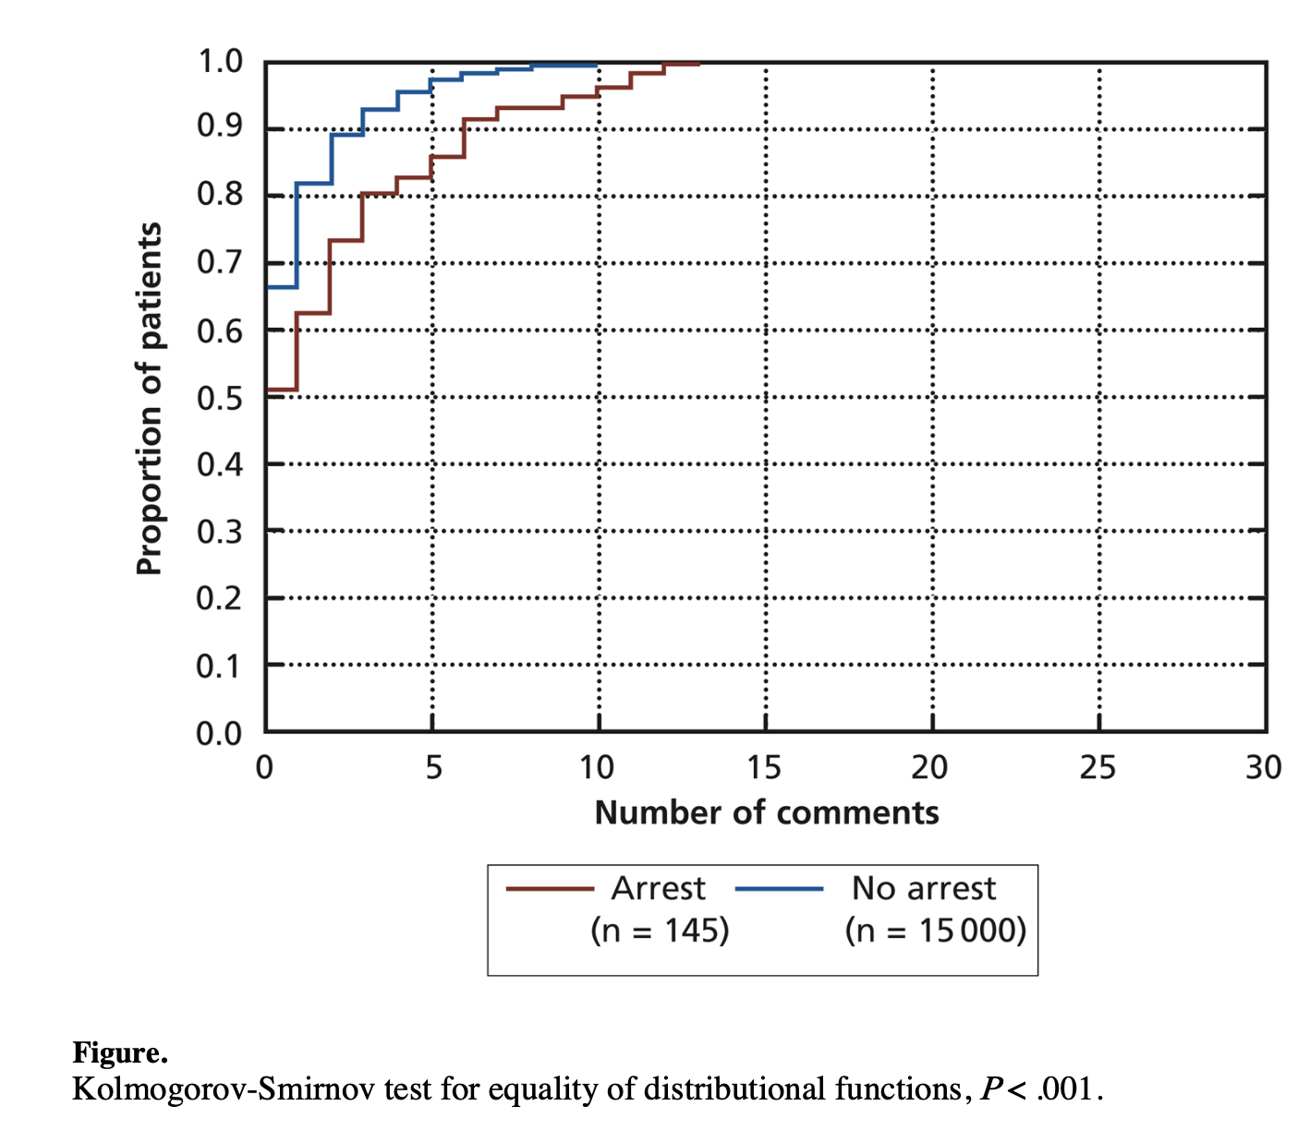
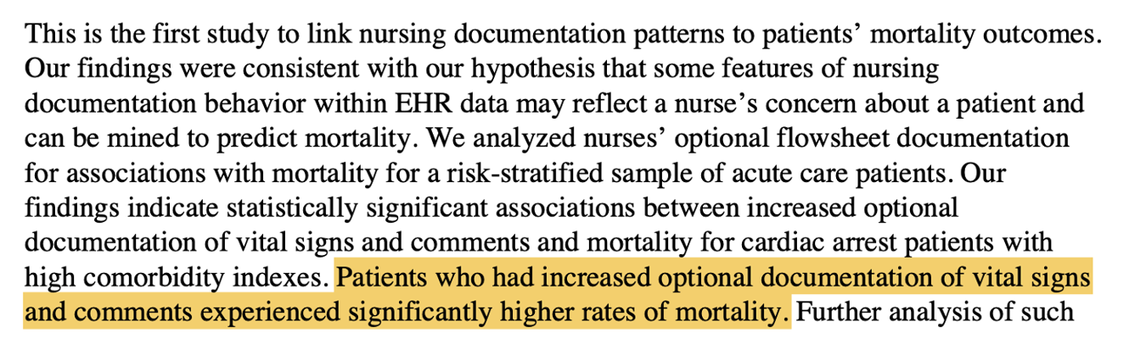
Motivating Example (3)
Collins SA, Cato K, Albers D, et al. Relationship between nursing documentation and patients’ mortality. Am J Crit Care 2013;22: 306-13. doi:10.4037/ajcc2013426
Notes:
This study looked at patients who were in the hospital for some time. Almost the opposite phenomenon. More documentation -> higher mortality.
Why might this be?
Again, correlation != causation.
Kolmogorov-Smirnov – max diff in CDF between 2 pdfs

Slide 9
Confounding Variable
Increased documentation in EHR
Higher mortality
Notes:
There is a confounder: What is it?

Slide 10
Confounding Variable
Increased documentation in EHR
Higher mortality
Very sick patient
Notes:
There is a confounder: What is it?

Slide 11
Today
Bias Snuck into My Model!
Predictive but Useless Features
Dataset Shift
Notes:
Theme: You can’t just throw your data at a model, Need to understand the data.
Now that we spent a little time on confounders, we’re going to park that until the causal inference lecture
Instead, we’re going to dig into 2 classic papers in MLH around bias. One assigned, one not.

Slide 12
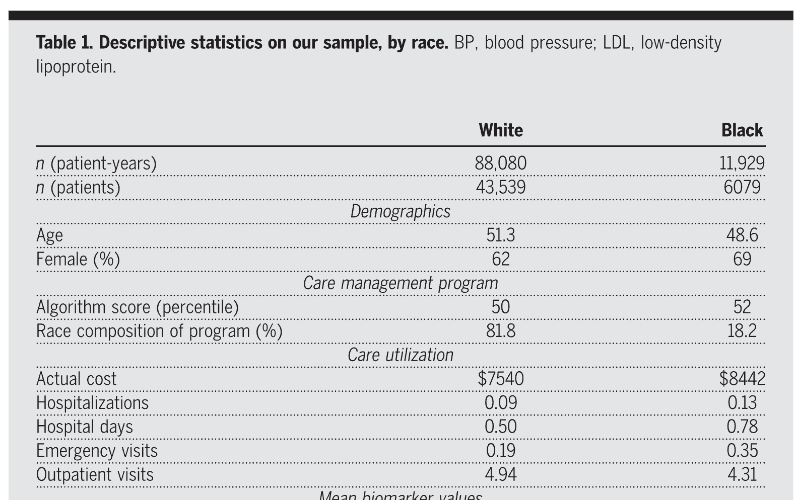
“Dissecting Racial Bias” Paper
Cohort: (Nearly) all primary care patients (~50K) at a large hospital enrolled in risk-based contracts from 2013 to 2015.
https://www.science.org/doi/epdf/10.1126/science.aax2342
Notes:
Obermeyer
Hospital – beth israel deaconess Medical Center (BIDMC)
“Table 1”
Often show p-value between two columns, to show whether the variance is considered statistically meaningful

Slide 13
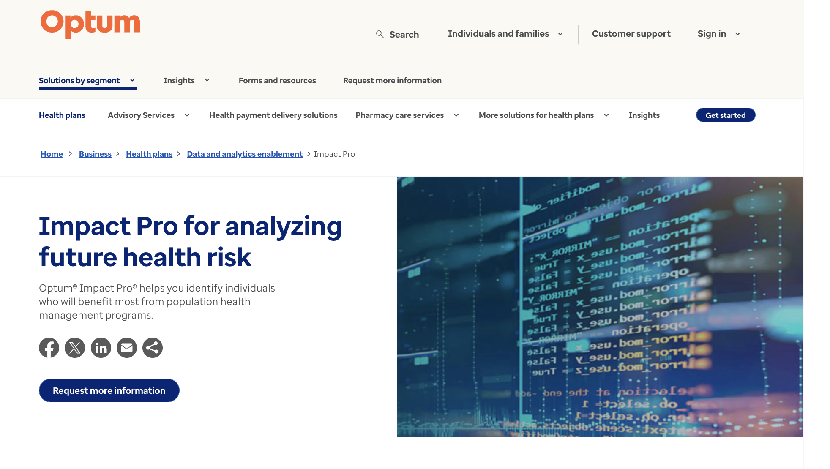
Notes:
The algorithm was embedded inf this Optum product
Example of passive, pop-level risk strat.
Q: Have we seen any Optum risk stratification models before? (Lek 3 – MI)
Product aimed at customers (payers, providers) to use in assigning care mgmt to patients

Slide 14
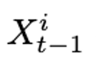

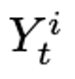
insurance claims
Demographics
Insurance type
dx and procedure codes
rx
Costs
Predicted healthcare costs for patient i in year t
Notes:
Optum algorithm is a black box.
Can see inputs and outputs. No idea what’s happening inside. Optum doesn’t tell us.
Goal: identify patients who are going to get very ill in the next year.
Using healthcare cost as a proxy for healthcare need.

Slide 15

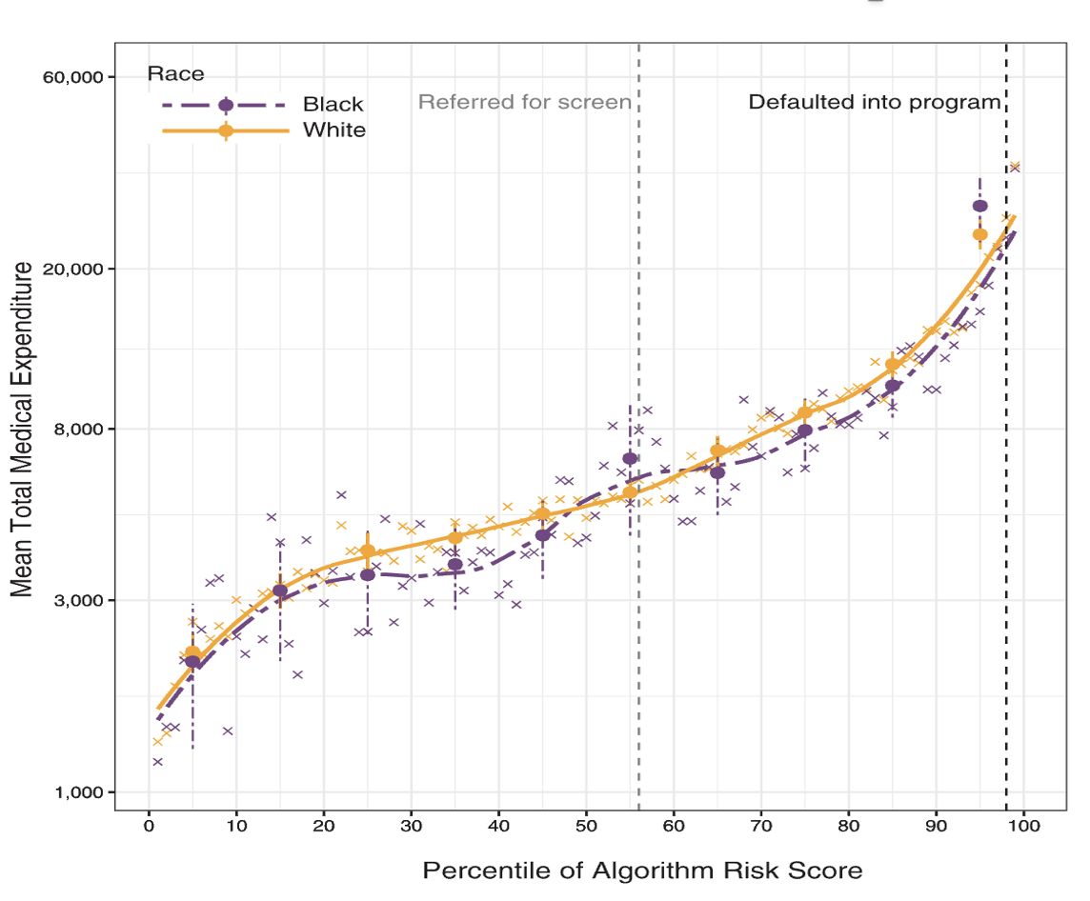
Score > 97%: invite patient to enroll in care management program
Score > 55%: refer patients to PCP
Notes:
From paper
Q: Who can explain the importance of these 2 vertical lines
Thresholds affect health outcomes!
From this plot (spend vs. risk), algorithm looks race-blind.
This is what you want to see, right? Overlapping lines. For people with a given assigned risk score, their spend is equivalent

Slide 16
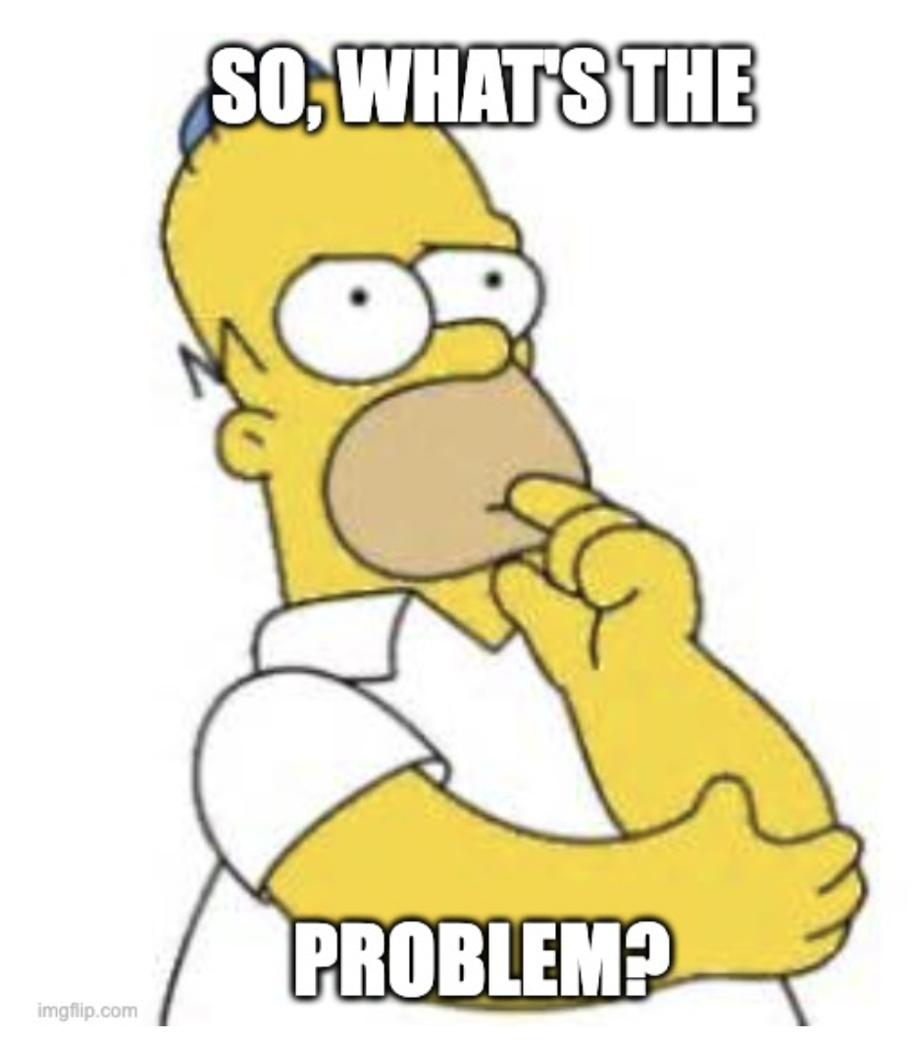
Notes:
Ok so black & white patients seeing the same exact correlation between risk score and healthcare spend. So at least in that sense, the algorithm is not biased by race.
Is there a problem here?
(hint: Is healthcare spend a reliable proxy for healthcare need?)

Slide 17
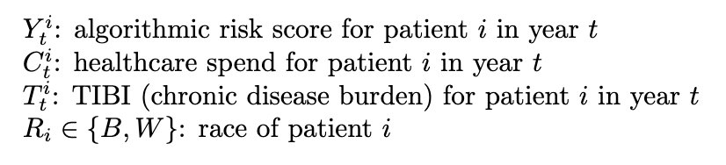
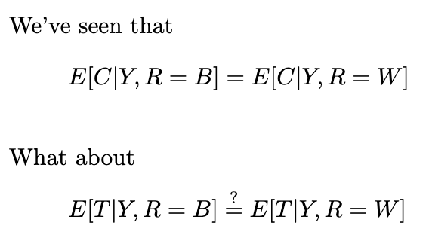
Notes:
Let’s formalize this just a little.
TIBI – total illness burden index (“ground truth”) – we’ll discss that next

Slide 18
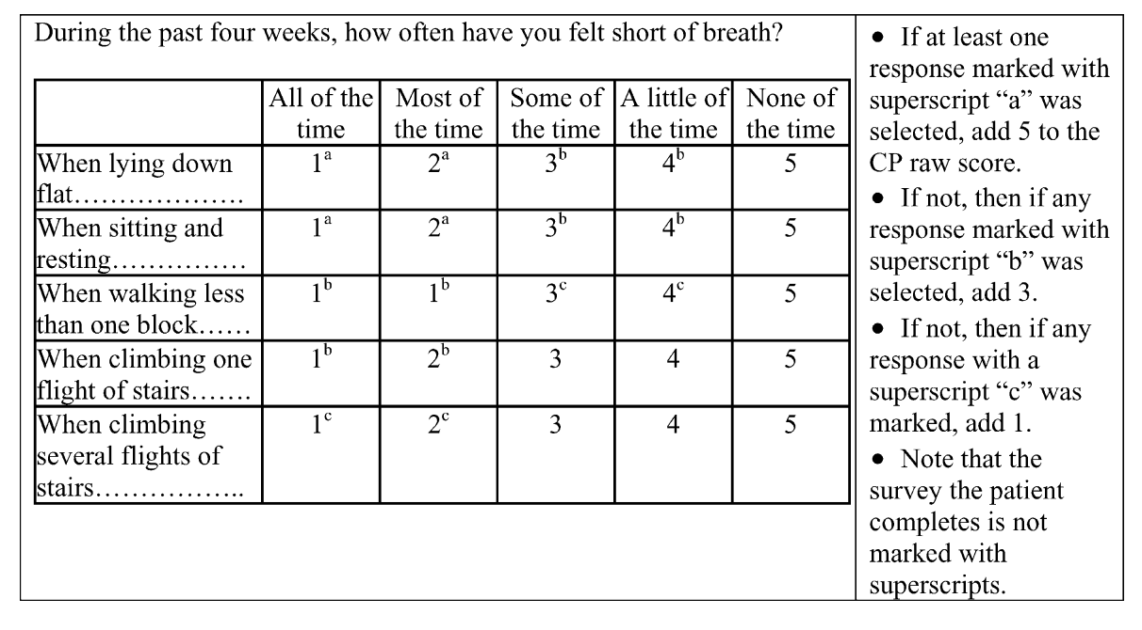
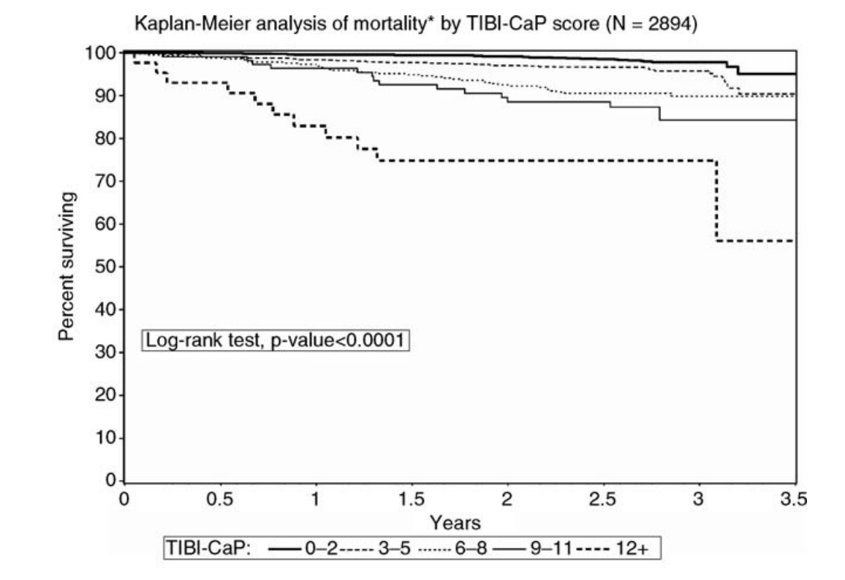
TIBI Score (Total Illness Burden Index)
https://link.springer.com/referenceworkentry/10.1007/978-0-387-78665-0_4
Notes:
TIBI= 15 minute questionnaire, > 100 questions Range = 0 … 100
A classic risk strat measures
Shown: specialized version for prostate cancer – Tibi-CAP
Right: KM curves – what does this show? (high correlation between TIBI-CAP score and mortality) Tibi-Cap -> for prostate cancer

Slide 19
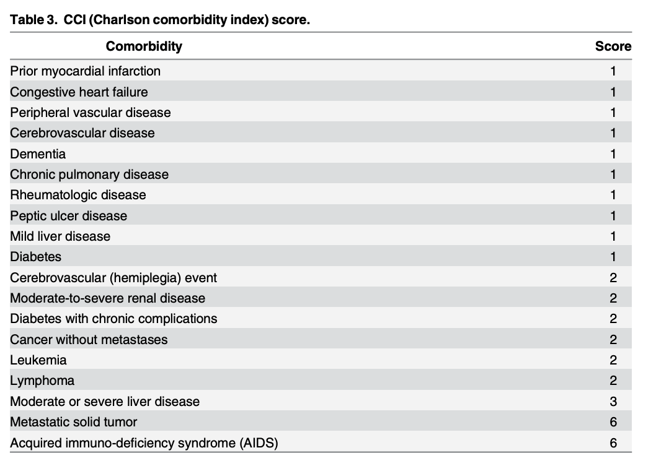
https://www.researchgate.net/publication/301936501_Prediction_of_Mortality_in_Incident_Hemodialysis_Patients_A_Validation_and_Comparison_of_CHADS2_CHA2DS2_and_CCI_Scores/link/572cab5208ae7441518e5f0c
Notes:
LOTS of other ways to quantify illness. Here’s one.

Slide 20
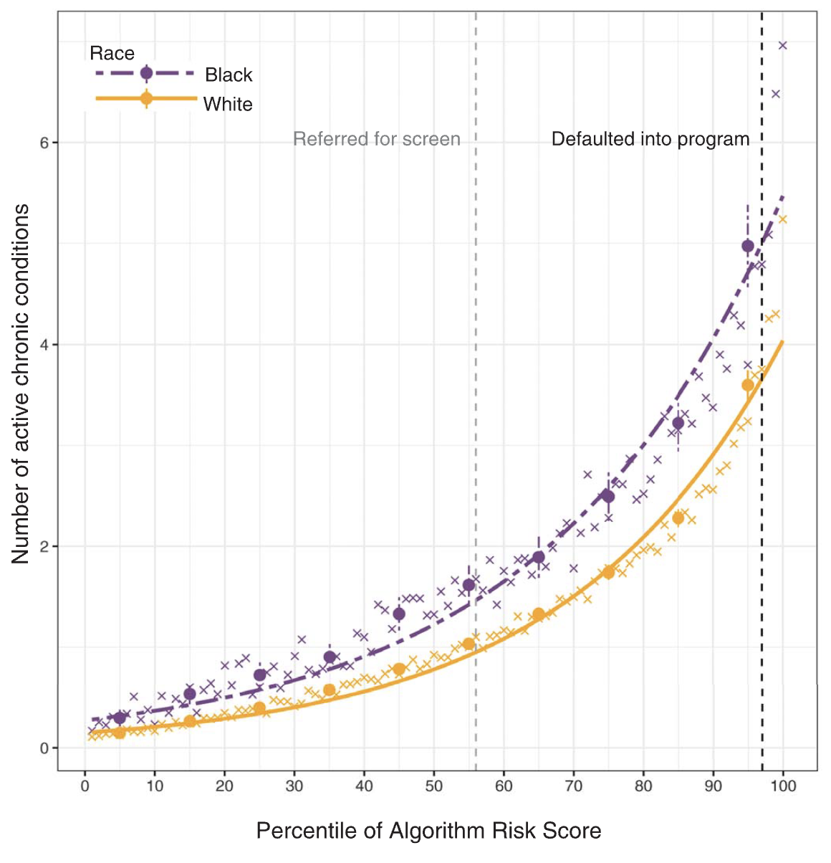
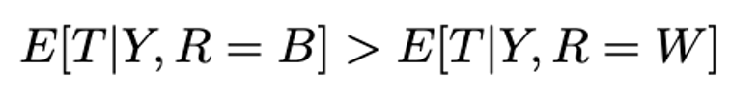
Looks like
TIBI
At all levels of assigned risk score, Black patients have a higher disease burden.
Notes:
Now we have a way to quantify illness. So we can look at assigned risk score vs. illness
What does this chart show?
1. At a given level of chronic illness, whites spend more than blacks on healthcare
2. At a given assigned risk score, blacks are sicker than whites

Slide 21
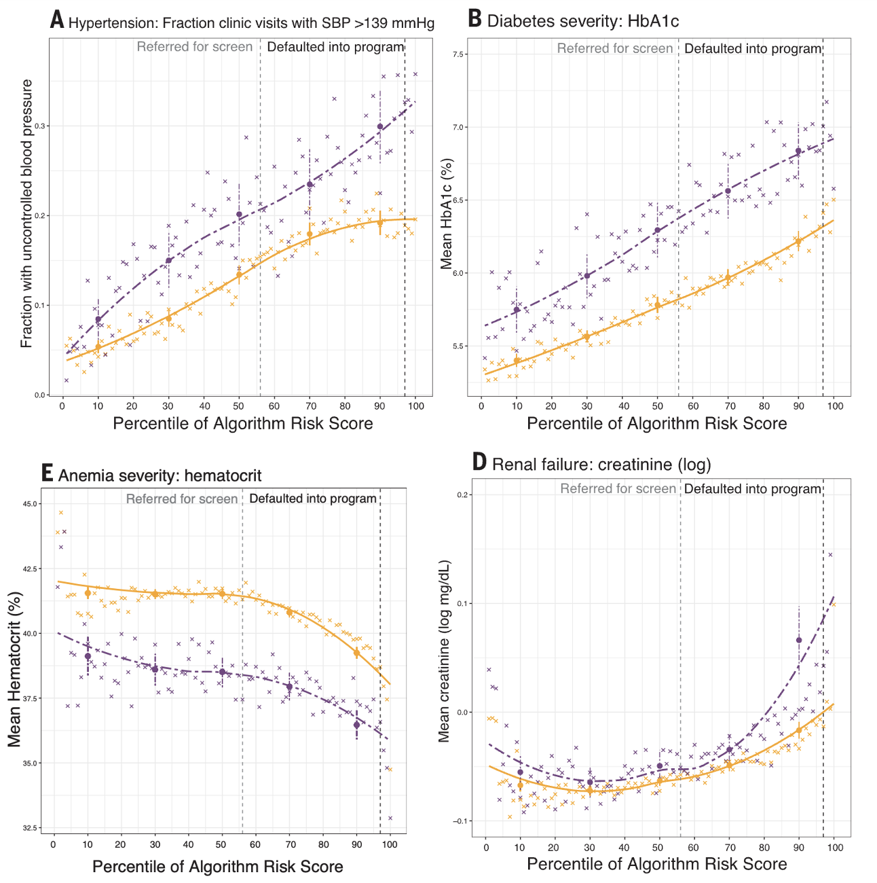
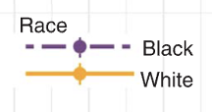
Notes:
Across different disease states
E: hematocrit – too low = anemia

Slide 22
Why does this matter?
Higher risk score
more care resources allocated to patient
Better health outcomes
Notes:
Higher risk score -> more care resources allocated to patient -> Better health outcomes

Slide 23
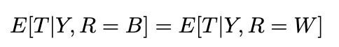
How could we reduce this disparity?
i.e. How might you ”fix” the algorithm so that
Notes:
The authors don’t just identify the disparity.
They come up with a method to address it.
(This part is from the paper’s supplementary material, which was not assigned)
Think for a sec how you might "fix" the Optum system to assign scores more fairly by race?

Slide 24
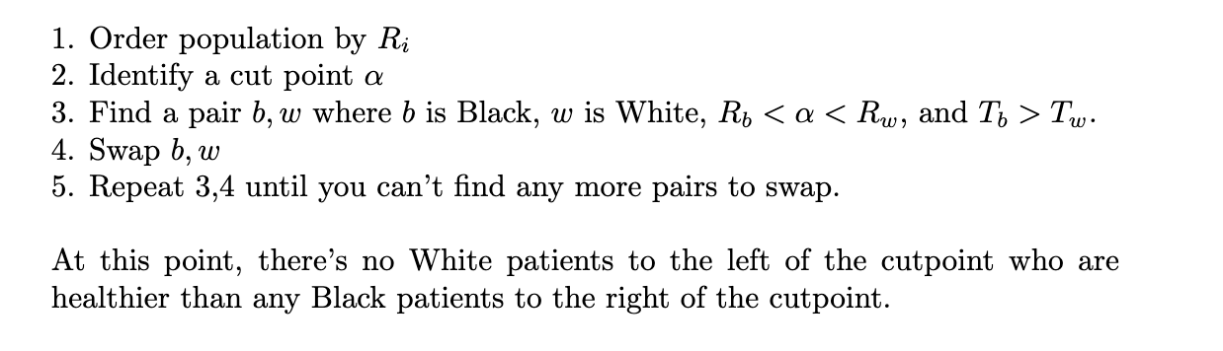
Notes:
Here’s what they did
Step 3: how could you interpret this pair of patients?
After 5: What can you say about the ordering now?
(They lie on opposite sides of the alpha risk cutoff, but with illness burden reversed)

Slide 25
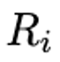
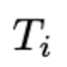
0.02 0.04 0.08 0.12 0.15 0.19 0.25 0.25 0.28 0.34 0.41 0.42 0.44 0.47 0.49
1 1 1 1 4 9 3 4 11 5 6 5 4 11 10
Notes:
(all animations)
What are we guaranteed when this algorithm terminates?
there’s no white person with risk > alpha when there’s a sicker black person with risk < alpha.
Any issues with this approach?
Hint: could there be SOMEONE to the left of the cutpoint who is sicker than (a white or black person) to the right? (yes, it has to be a white person)
Hint: what about a pair of mismatched patients BOTH to the left of the cutpoint?

Slide 26


0.02 0.04 0.08 0.12 0.15 0.19 0.25 0.25 0.28 0.34 0.41 0.42 0.44 0.47 0.49
1 1 1 1 4 9 3 4 11 5 6 5 4 11 10
0.02 0.04 0.08 0.12 0.15 0.19 0.25 0.25 0.42 0.34 0.41 0.28 0.44 0.47 0.49
1 1 1 1 4 9 3 4 5 5 6 11 4 11 10
Notes:
(all animations)
What are we guaranteed when this algorithm terminates?
there’s no white person with risk > alpha when there’s a sicker black person with risk < alpha.
Any issues with this approach?
Hint: could there be SOMEONE to the left of the cutpoint who is sicker than (a white or black person) to the right? (yes, it has to be a white person)
Hint: what about a pair of mismatched patients BOTH to the left of the cutpoint?

Slide 27


0.02 0.04 0.08 0.12 0.15 0.19 0.25 0.25 0.28 0.34 0.41 0.42 0.44 0.47 0.49
1 1 1 1 4 9 3 4 11 5 6 5 4 11 10
0.02 0.04 0.08 0.12 0.15 0.19 0.25 0.25 0.42 0.34 0.41 0.28 0.44 0.47 0.49
1 1 1 1 4 9 3 4 5 5 6 11 4 11 10
0.02 0.04 0.08 0.12 0.15 0.41 0.25 0.25 0.42 0.34 0.19 0.28 0.44 0.47 0.49
1 1 1 1 4 6 3 4 5 5 9 11 4 11 10
Notes:
(all animations)
What are we guaranteed when this algorithm terminates?
there’s no white person with risk > alpha when there’s a sicker black person with risk < alpha.
Any issues with this approach?
Hint: could there be SOMEONE to the left of the cutpoint who is sicker than (a white or black person) to the right? (yes, it has to be a white person)
Hint: what about a pair of mismatched patients BOTH to the left of the cutpoint?

Slide 28
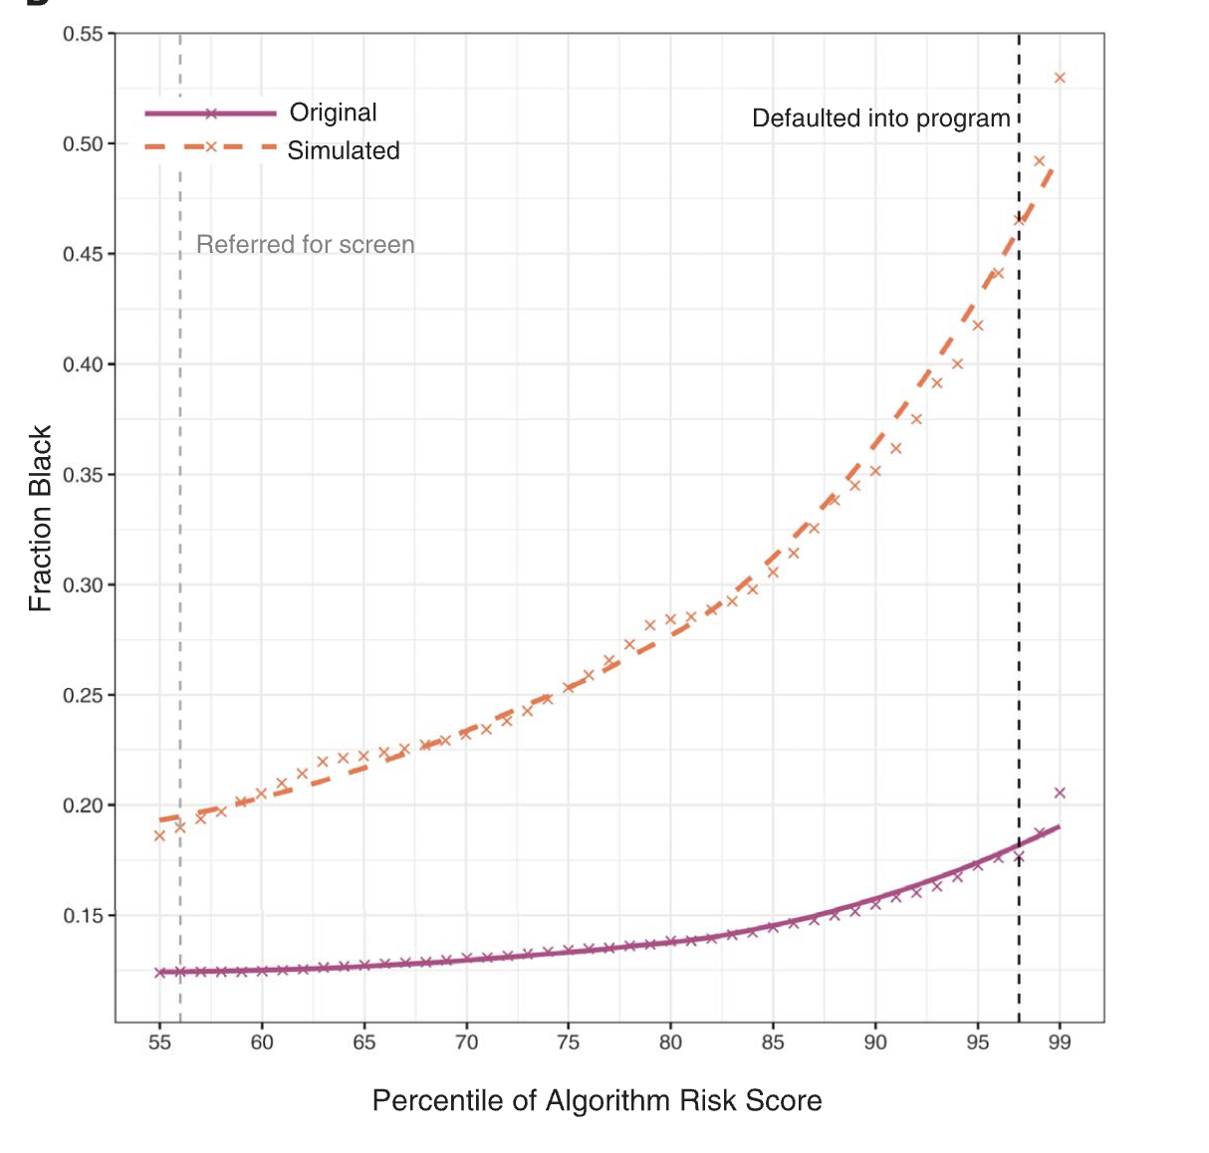
17.7% to 46.5%
Notes:
The ”counterfactual graph” – what would have happened if you performed the swap
Note the jump in black patients who would be auto enrolled in the care mgmt. program
Tells you how much you should "boost" the scores of black patients

Slide 29
Does Racial Discrepancy = Bias?

Slide 30
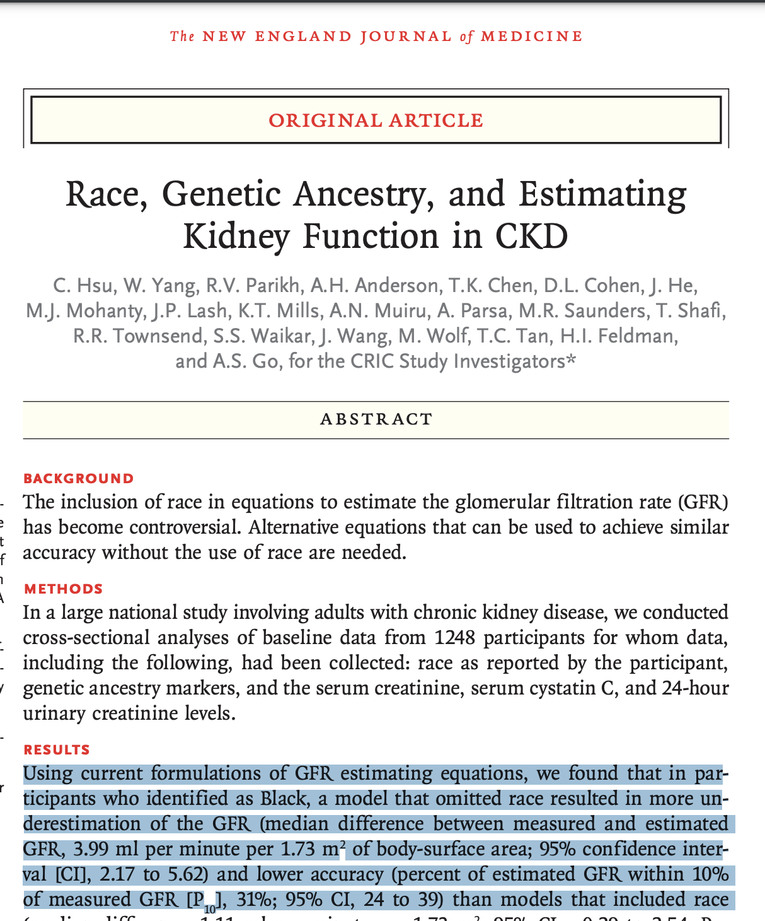
Does Racial Discrepancy = Bias?
Notes:
Sometimes there are underlying clinical differences. Race can be a legitimate feature.
Ex: eGFR – glomular filtration rate. Diff between races.
This paper actually tried to build a model to estimate kidney function in patients without using eGFR, could not.

Slide 31
Today
Bias Snuck into My Model!
Predictive but Useless Features
Dataset Shift

Slide 32
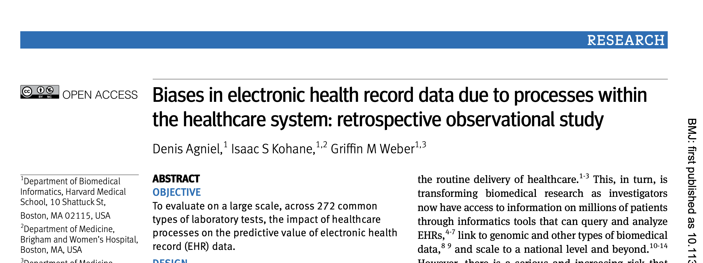
https://www.bmj.com/content/bmj/361/bmj.k1479.full.pdf
Notes:
Keep developing our intuition around biases. In this case, they call it ‘process bias’
We looked at a different Kohane paper last week -> “looking over shoulder of clinicians

Slide 33
Setup
~700K patients treated at 2 Boston hospitals over one year (2005-6)
Examined 272 lab tests
For each test, measure correlation between each of the following against 3-year survival:
Time of day of test
Day of week of test
Ordering frequency of test
Value of the test result
Notes:
(GAM model between covariates and outcome)

Slide 34
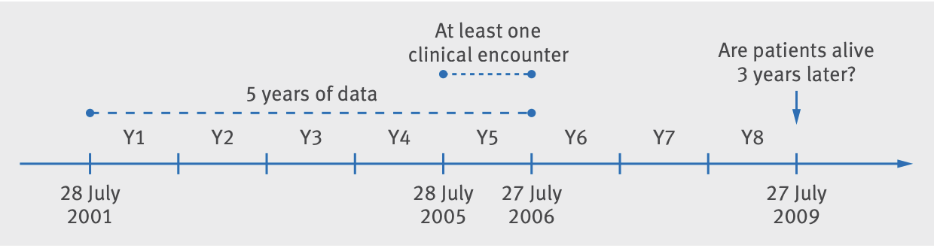
Notes:
Here’s the setup
Technical point described in paper: How to know if the patient was alive after 3 years? Looked at EHR snapshot from 3 years after study ends – July 27 2009.

Slide 35

In what % of the lab tests was time of day the lab was ordered MORE predictive than the value of the lab result?
0%
5%
10%
>10%
Notes:
Let’s do a poll

Slide 36
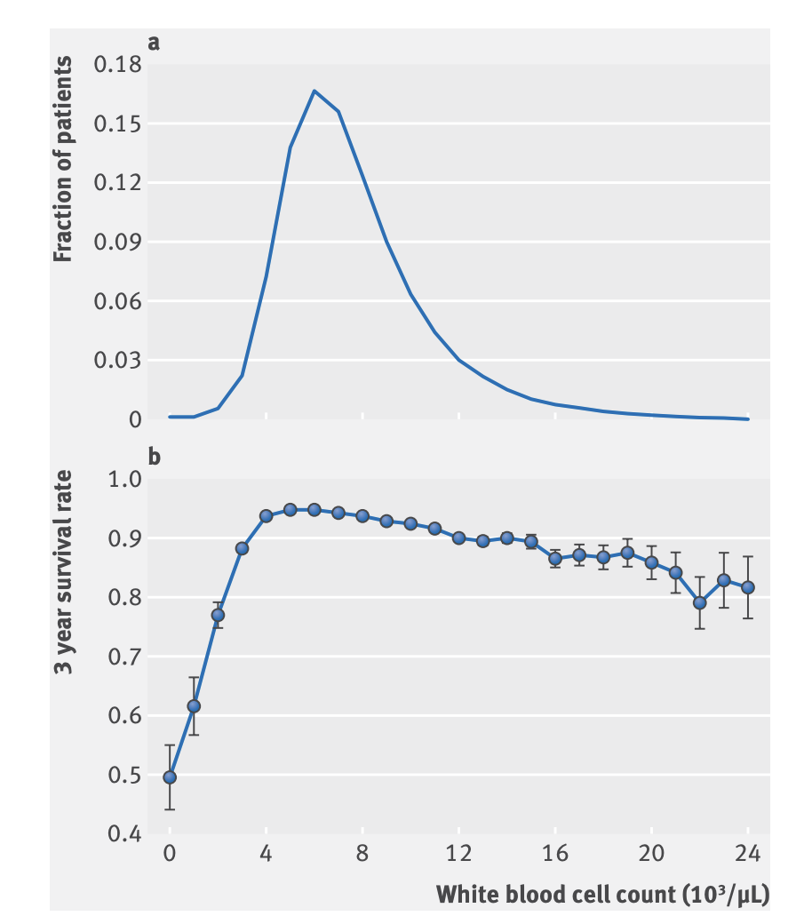
Notes:
Let’s dig in
WBC is a very common lab test
Low WBC Count (Leukopenia): This can suggest bone marrow problems, autoimmune diseases, severe infections, or the effects of certain medications or treatments like chemotherapy.
High WBC Count (Leukocytosis): This can indicate infections, inflammation, trauma, stress, leukemia, or other blood disorders.

Slide 37
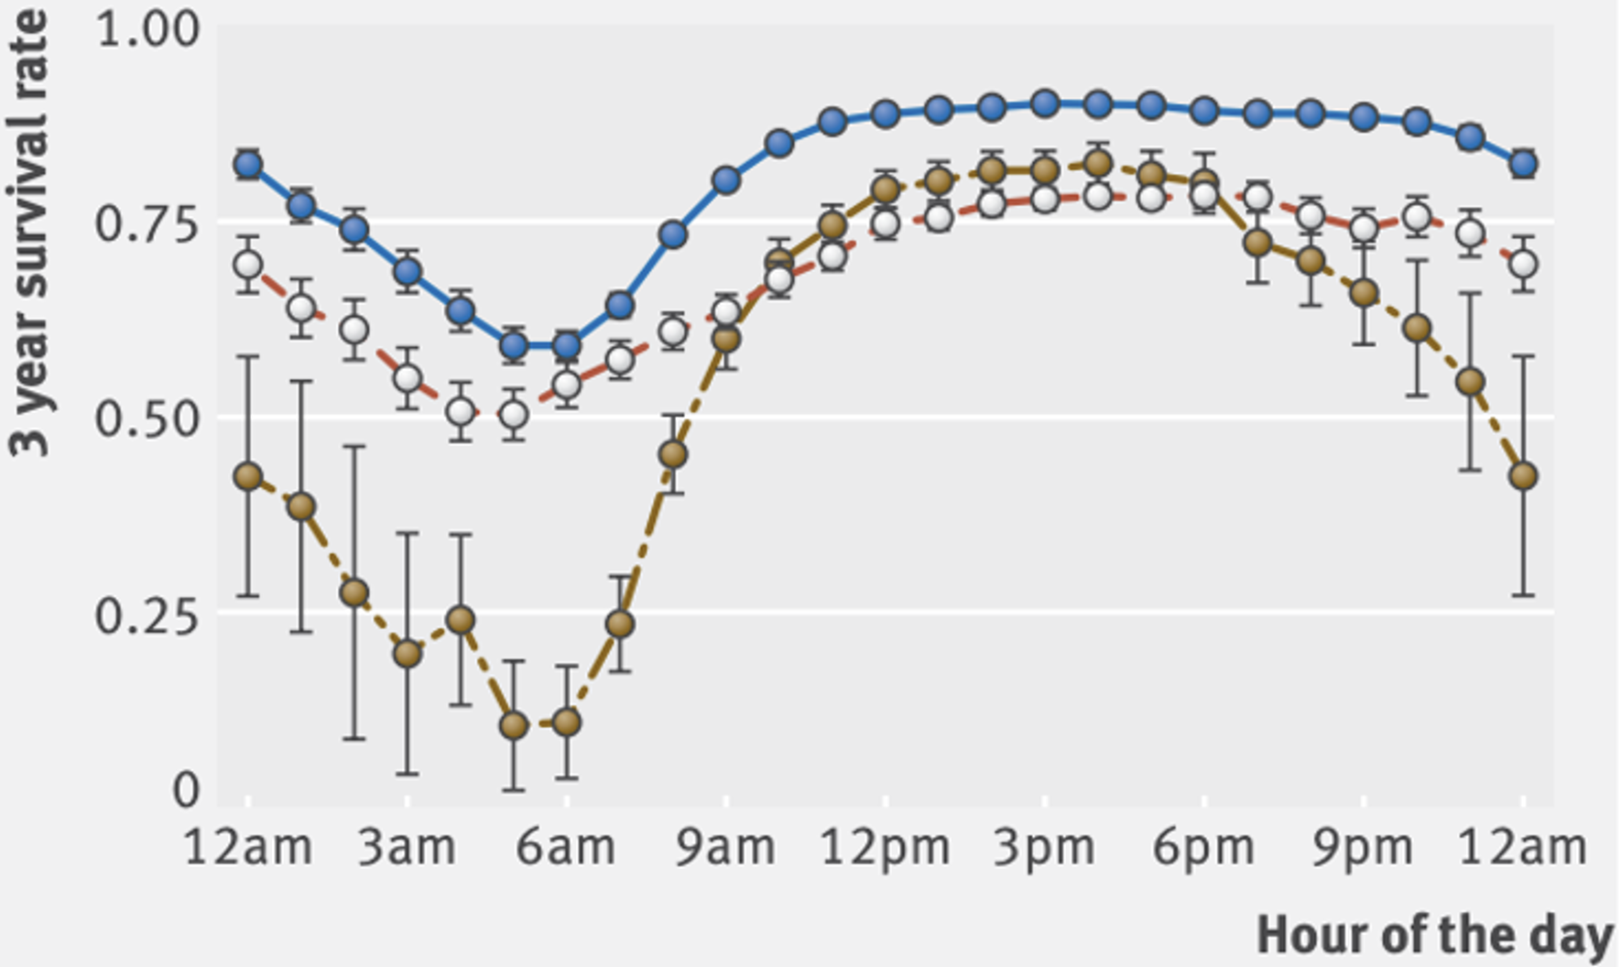
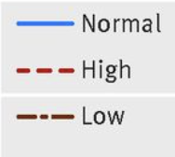
Notes:
what the heck is going on here.
(a normal test result at 3AM -> lower 3yr survival than a low at 3pm!)
Fun fact: someone who gets a test at 3AM that comes back normal has lower 3y survival than someone with a test at 3pm that’s abnormal.
No learning here – this is just ratios – look at all the patients who had a test at 3AM, how many were alive at 3 years?

Slide 38
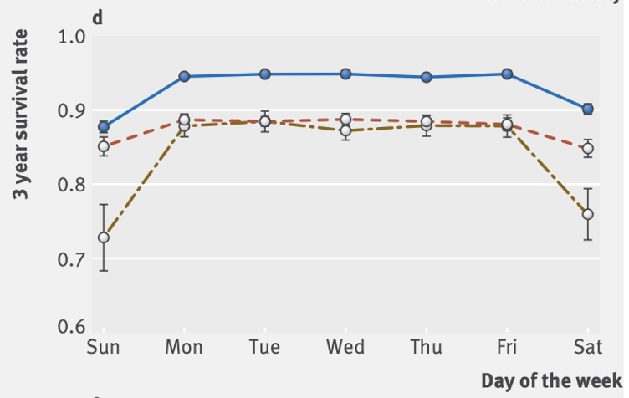
Notes:
By day of week.
Sat/sun - hospital is much quieter, fewer tests ordered

Slide 39
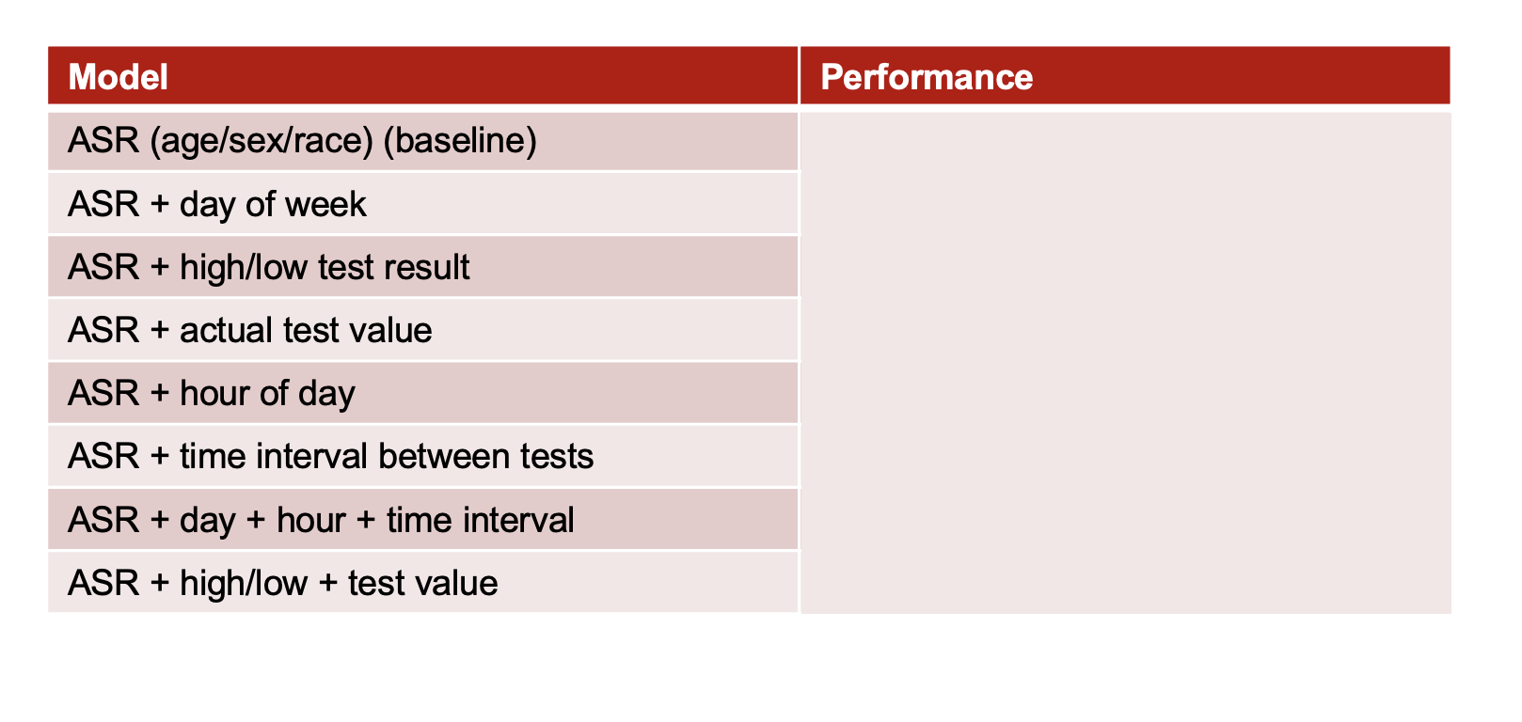
Results
All 669,452 patients treated at 2 Boston hospitals in 2005-6
Looked at 210 lab tests conducted on these patients
For all patients with at least 2 WBC labs.
Notes:
guess on which does the best?

Slide 40
Results
Model | Performance
ASR (age/sex/race) (baseline) | 0.06955 Brier Score
ASR + day of week | 1.01% better than baseline
ASR + high/low test result | 3.00% better than baseline
ASR + actual test value | 3.33% better than baseline
ASR + hour of day | 4.56% better than baseline
ASR + time interval between tests | 7.57% better than baseline
ASR + day + hour + time interval | 8.44% better than baseline
ASR + high/low + test value | 3.72% better than baseline
All 669,452 patients treated at 2 Boston hospitals in 2005-6
Looked at 210 lab tests conducted on these patients
For all patients with at least 2 WBC labs.
Notes:
Note the final two rows

Slide 41
Results
Data about the timing of when [lab] tests were ordered were more accurate than the test results in predicting survival in 118 of 174 tests (68%).

Slide 42
Confounding Variable
Lab test ordered at 3AM
High 3-Year Mortality
Very sick patient
Notes:
I lied before when I said I was done talking about causality
The “test was ordered at 3am” is obviously not a causal driver for 3-year mortality, disease state, or anything clinical.
What’s the confounding variable?

Slide 43
Halftime
Notes:
I

Slide 44
Today
Bias Snuck into My Model!
Predictive but Useless Features
Dataset Shift

Slide 45
Machine Learning is Brittle
You train your model on data from Springfield General Hospital. You validate it. You run a prospective study there. Everything looks good! You deploy it.
What could go wrong?
Now your colleague at County General Hospital wants to use it. What could go wrong?
Notes:
What could go wrong?
Non-stationarity (e.g. covid - CPT code 87428. This code was introduced for the rapid antigen tests for covid.
We talked about non-stationarity in lek 3 – one of the ‘gotchas’ for risk strat.
Problem: ML assumption is that underlying data is constant from training -> deployment. Pretty much never true.

Slide 46
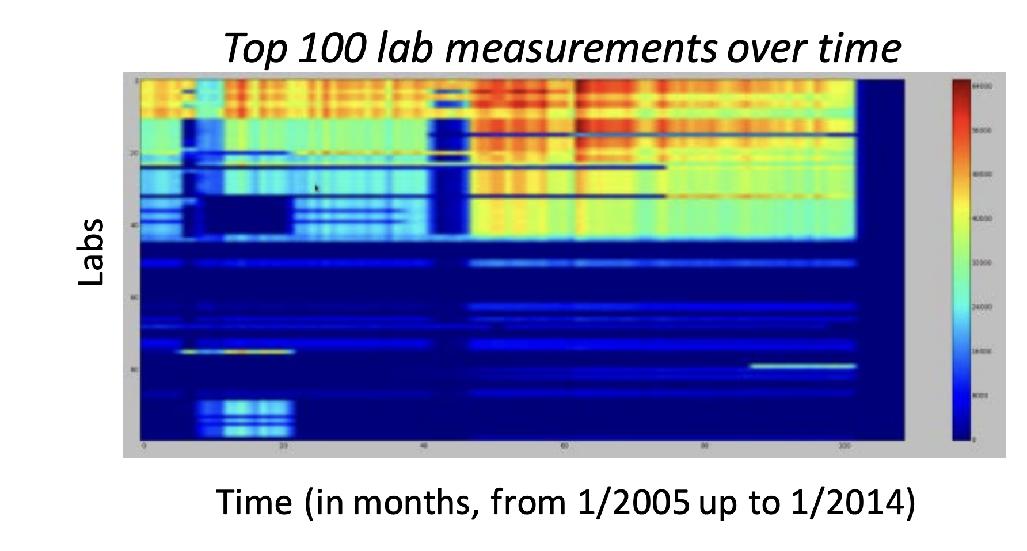
Notes:
Let’s make this more concrete w/ 2 examples
Here each row is a different lab
If they were constant freq. over item, then each row would be a constant color.
Q: reasons for variation?
- new test
- reimbursement
- seasonality (RSV? Allergy?)
- new diseases (covid?)

Slide 47
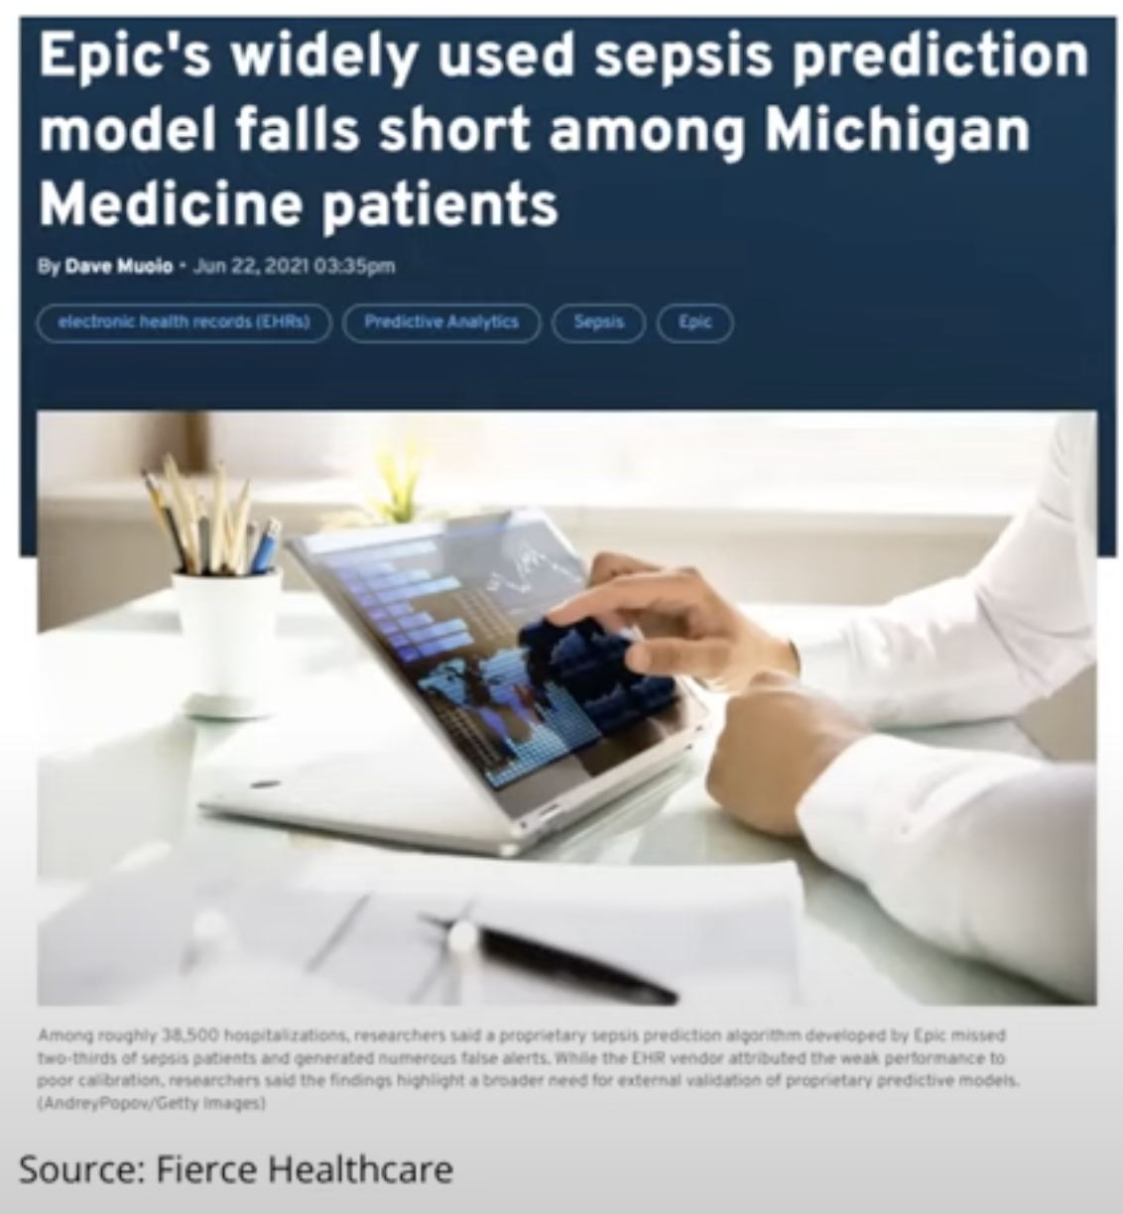
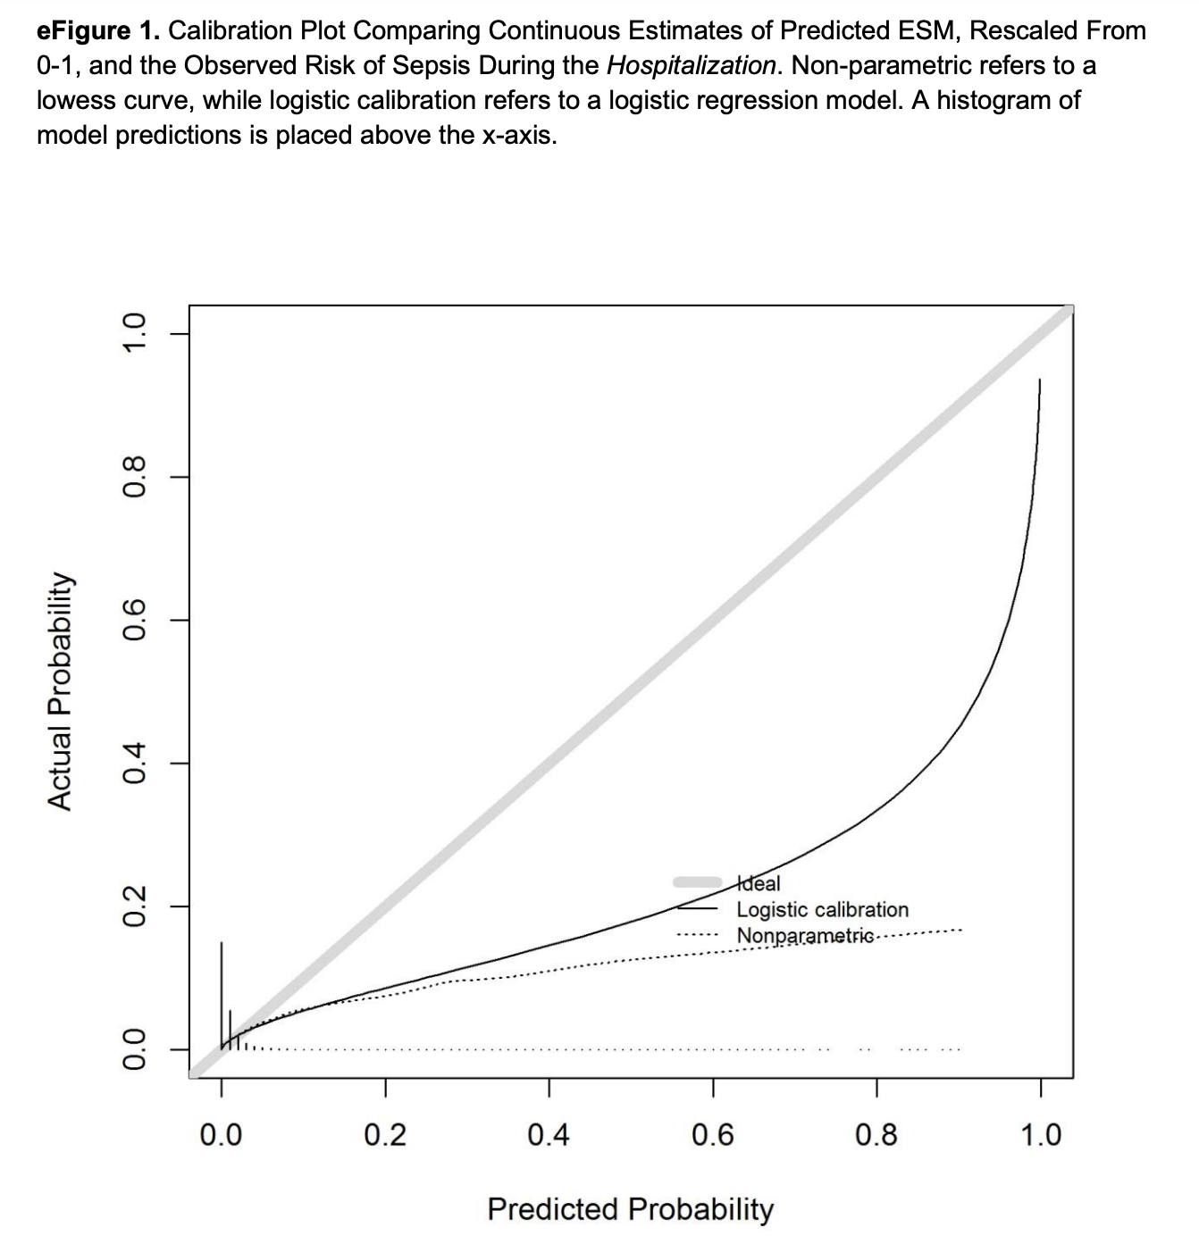
“Our observed hospitalization-level model performance (AUC, 0.63) was substantially worse than that reported by Epic Systems (AUC, 0.76-0.83)”
https://ja.ma/3xymYCo (and supplementary material)
Notes:
2nd example - Tested epic sepsis module at Univ. Michigan (talked about this briefly in lek 5)
Right – calibration plot. Yet another way to evaluate an ML classifier
sidebar: How calibration plots work: take all predicted probabilities, bin them into 10 bins (say), calculate empirical prob in that bin.
Test your understanding: below the diagonal means what? (too high/aggressive in its predictions.)

Slide 48
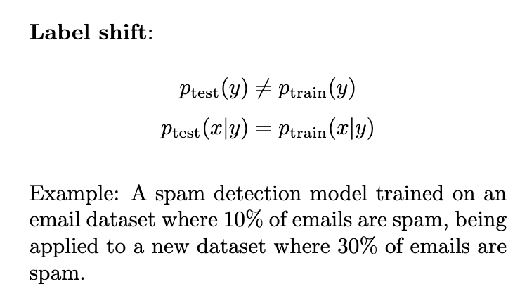
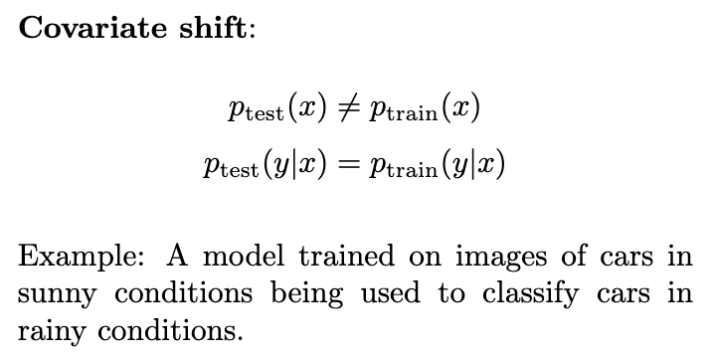
Types of Distribution Drift
https://icml.cc/2012/papers/625.pdf
Notes:
Label shift: The proportion of spam has changed, but the characteristics of spam emails remain similar.
Covariate: The input distribution $p(x)$ has changed, but the relationship $p(y|x)$ between car features and car types remains the same.
(assumptions about p(x|y) and p(y|x) constant are simplifying assumptions)

Slide 49
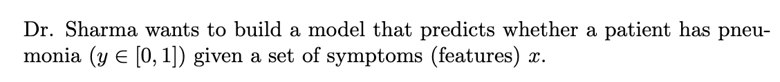
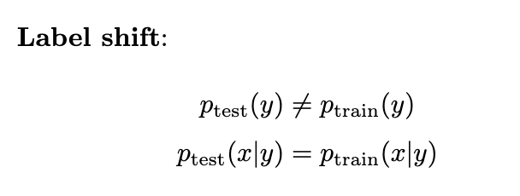
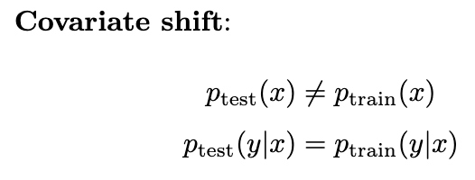
Example?
Example?
Notes:
Ok, now let’s see how well you understand.
Label: more people getting pneumonia (it’s the winter, model was trained on summer data). But given a set of symptoms, p(y|x) doesn’t change
Covariate: model trained on adults being applied to children (x: temperature or breathing rate -> different in children)
*** We’re going to focus on covariate shift – it’s much more studied, although Prof Lipton and others have recently published on label shift.
Sometimes called transfer learning

Slide 50
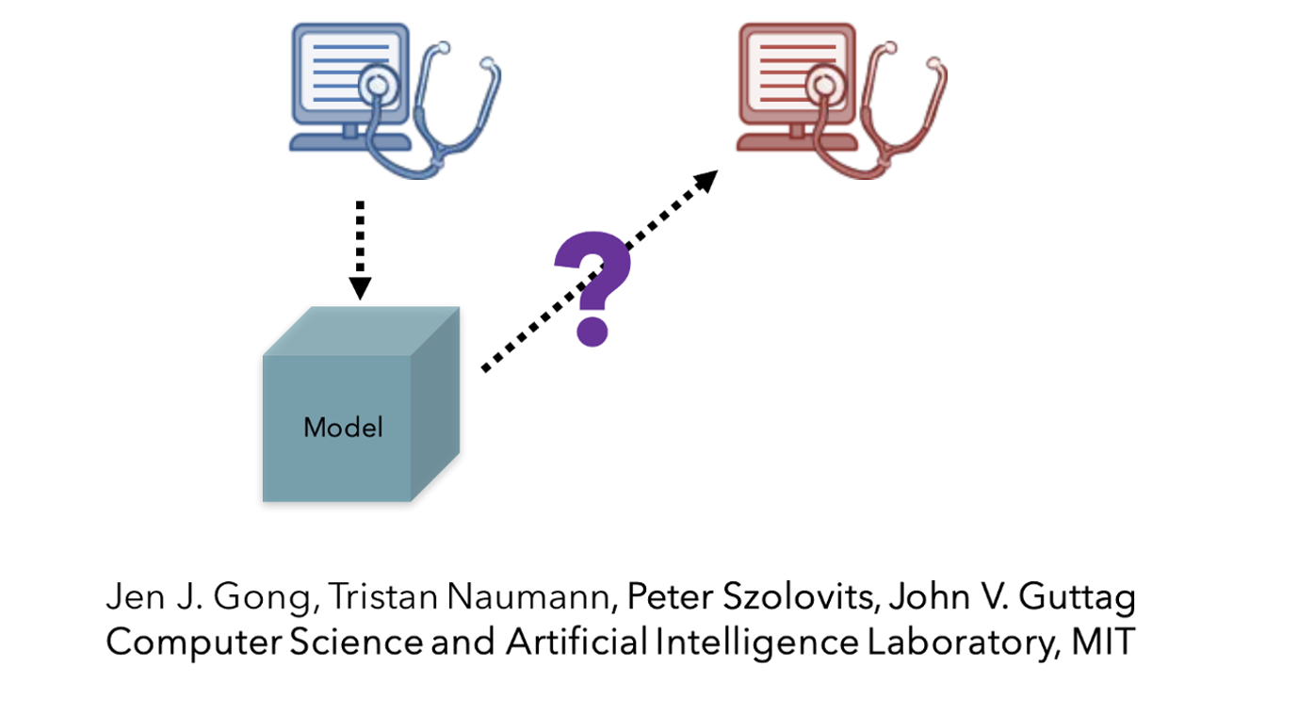
Next several slides: https://ocw.mit.edu/courses/6-s897-machine-learning-for-healthcare-spring-2019/resources/lecture-24-robustness-to-dataset-shift/
https://dl.acm.org/doi/pdf/10.1145/3097983.3098064
Notes:
let's use our favorite example - switching from one EHR to another

Slide 51
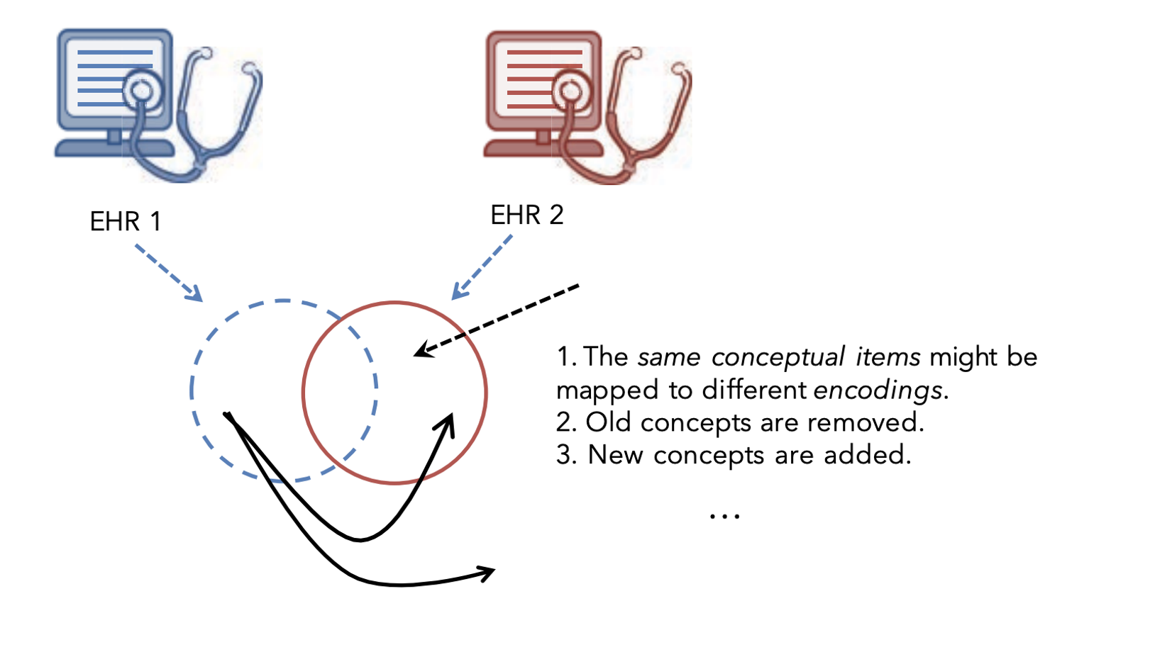
What Happens When You Switch EHRs?

Slide 52
Examples
EHR 1 | EHR 2
Allergies documented using free-text | Allergies selected from a drop-down
Uses ICD-9; e.g. 585.9 (Chronic kidney disease, unspecified) | Uses ICD-10 e.g. N18.3 (Chronic kidney disease, stage 3).
uses British units; e.g. Glucose: 90 mg/dL | uses international units, e.g. Glucose: 5.0 mmol/L

Slide 53
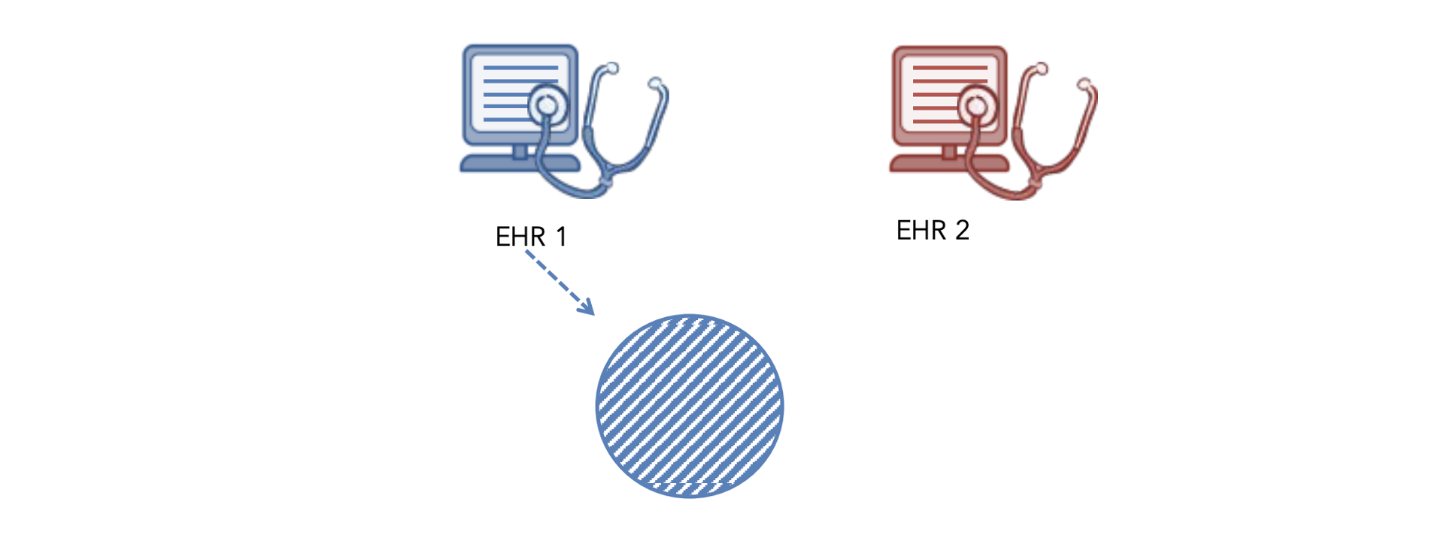
Approach 1: Learn model from EHR1, Apply to EHR2
Notes:
What’s wrong w this approach?

Slide 54
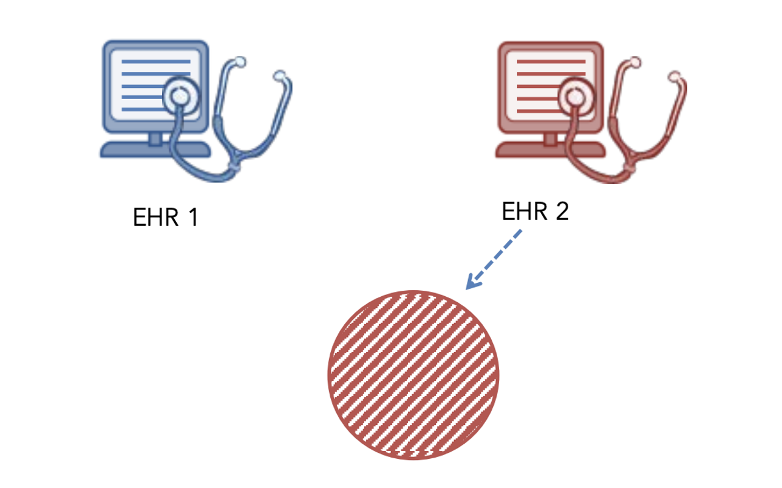
Approach 2: Learn model from EHR2
Notes:
What’s wrong w this?
(Discards valuable data from EHR1)

Slide 55
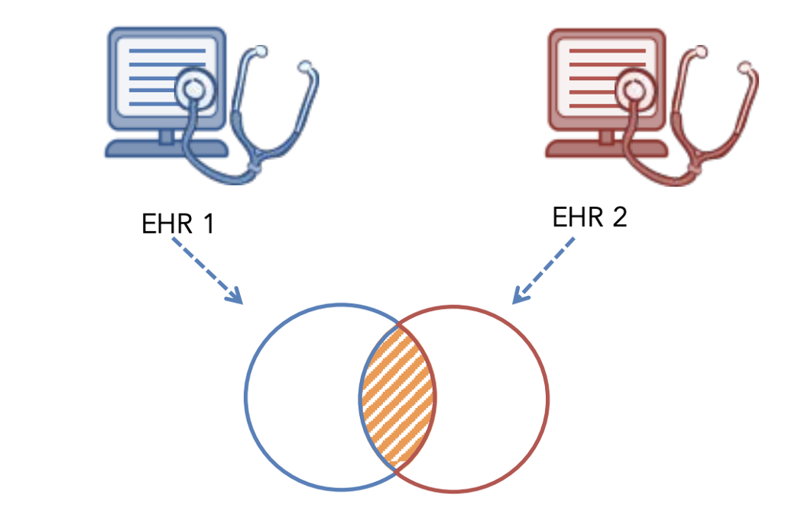
Approach 3: Use EHR1 ⌒ EHR2
Notes:
What’s wrong w this?
(Could be a small overlapping set )

Slide 56

Approach 4: Map Semantically Similar Items to Shared Vocab
Notes:
THIS is what the paper describes

Slide 57

Problem Setup
Notes:
Should look familiar
(avoid leaky labels)

Slide 58

Bag of Events Model
Notes:
Study performed using Mimic (Physionet)
Every event has a unique numeric code.
For a patient, we create a vector containing, for each code, the # of times that code appeared for this patient

Slide 59


Map to a Shared Vocab
Notes:
New hospital uses different codes. Thus, we can’t transport model from first hospital to second one.
Map the numeric code for each event to the text description of that code.
(Target codeset happens to be UMLS here)

Slide 60

Experimental Setup
Notes:
How did the authors evaluate this approach?
Look at MIMIC data in CareVue era and in Metavision era

Slide 61

Q1: How well does ‘raw events’ model work?
Notes:
No surprise: Raw events > SAPS since SAPS is by design simple – optimize for portabability

Slide 62

Within one EHR
Notes:
This is a ‘friendly’ setting for raw events model -> one fixed EHR for train/test
Still same single, fixed EHR -> one fixed EHR for train/test
Color change (Annoying): Red is now SAPS + raw item IDs

Slide 63

Across EHRs
Notes:
ItemID model craps the bed now. Not surprising.
CUI model, which wasn’t v promising in a fixed EHR world, suddenly shines

Slide 64
EOL

